Slide 1




BEHAVIORAL ANALYTICS FOR DETECTING ANOMALIES IN FINANCIAL TRANSACTIONS
Problem statement -3
SHAASTRA-ENCRYPTCON
PRESENTED BY : TEAM-VTK
Vishwajeet Bharadwaj
Kaavya SK
Thirusha M

Slide 2

Problem Statement
Approach
Agenda
Data-set
Working
Future Scope

Slide 3







Tech stack

Slide 4

Plan of Action
Website
Analysis Interface
Anomaly Patterns
Security Enhancement
Back to Agenda

Slide 5
Problem-Statement
The challenge of implementing and improving behavioral analytics solutions for detecting anomalies in financial transactions is crucial for enhancing security against fraudulent activities. This task involves leveraging the data and perform analysis to develop a system that can effectively identify suspicious (Anomalies) behavior within the vast volume of financial transactions.

Slide 6
Data-set
A suitable data-set that involves financial transaction data is used for training the model on distinguishing the anomalies. Here note that the data-set is not targeted (without target class .
Since there does not exist a output class priorly specified in the transaction data) leads to the development of an unsupervised machine learning model .
The Data set consists of 8 attributes out of which 6 attributes can be taken into consideration after pre-processing

Slide 7
Approach
The overview of the approach focuses on identifying anomalies and it’s reasoning patterns (cause-effect)
by following a series of steps on achieving data collection, integration, training & tuning the model, feature engineering, behavioral profiling and authentication reaction set-up.

Slide 8

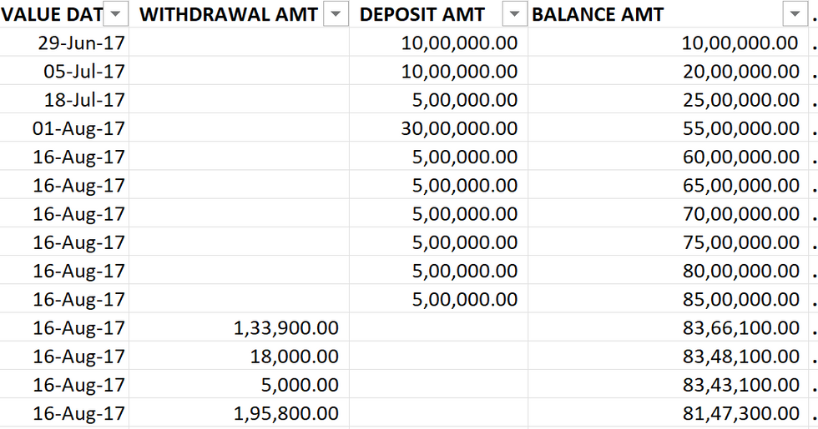
Pre-Processing
The data-set is to be initially set to handle imbalances as the data is of large size approx 1.5L+ entries of transactions .It includes imbalances like Nan values
( For example : A transaction may be either of type withdrawal or deposit which may be lead to Nan values in the records)

Slide 9
Study-Analysis
It analyzes the nature of the data-set with respect to each account and observe any affecting factors that can used as parameters / hyperparameters for our learning model based on Frequency and magnitude
For example :
Frequency -- Average No of withdrawal per month
Magnitude --Average amount withdrawed

Slide 10
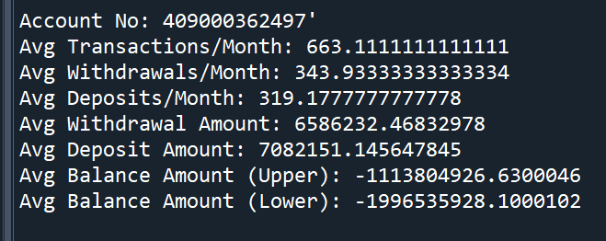
Training model
We have opted for the usage of isolated forest machine learning model
(unsupervised) that follows ensemble learning and focuses on isolating the anomalies in the data-set that employs isolation and tracking of the anomalies in the subset (tree) of the data that ensures each tree captures different aspects of the overall pattern in the data .Feature influence and importance is also supproted in this model that enables us to locate and identify the outliers (Anomalies) from the historical finance transaction data . Hyperparameters can be chosen and applied for tuning and optimizing the model’s performance

Slide 11


Behaviour
Create behavioral profiles for users and entities based on historical transaction data.
Regularly update profiles to adapt to changes in user behavior and transaction patterns.

Slide 12
Reaction-set
Once the model is succesfully trained and an incoming transaction is faced and detetcted as an anomaly , This can lead to prompt of MFA authentication like delivering OTP to a mobile for procedding with the transaction based on the strength of anomaly prediction. This can ensure the security and improvement of transaction after identifying the anomalies in the transactions

Slide 13
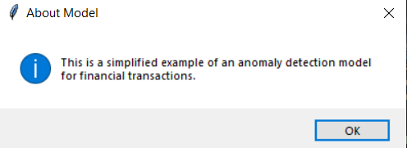
Working
The project is built in Python with a GUI using Tkinter screen that gives the anomaly pattern analysis with it’s behavior. It is a assumed to be a 2nd layer interface that handles the transaction details and predicts it as anomaly with its respective pattern & probability

Slide 14
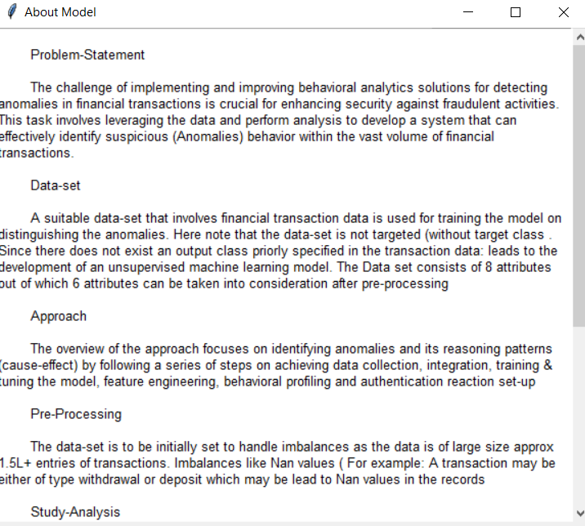


Slide 15
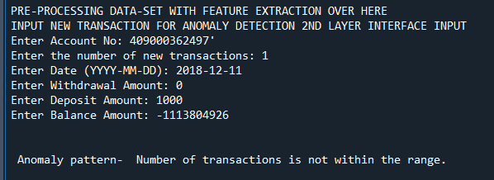
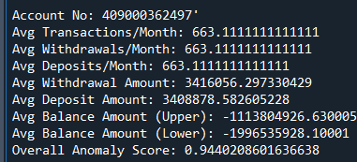
Model’s working

Slide 16
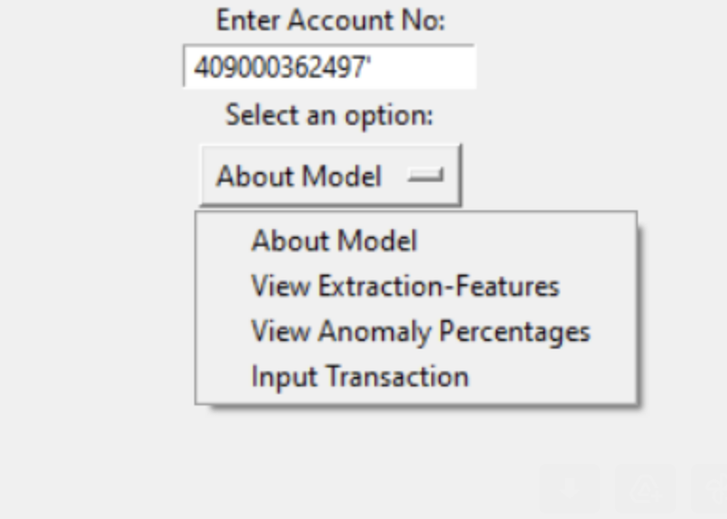
Model’s working

Slide 17
Model’s working

Slide 18
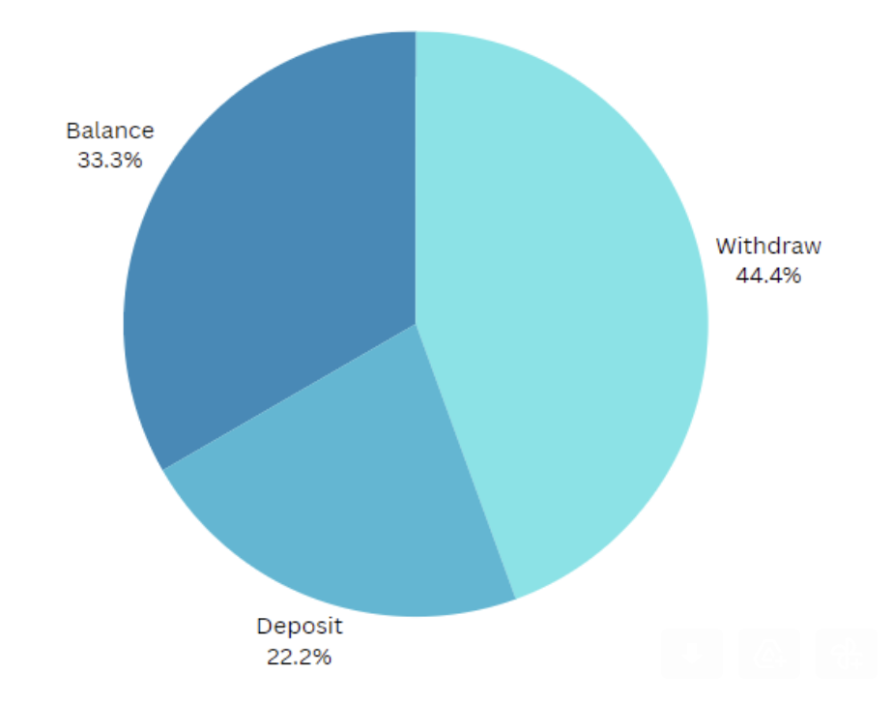
Sample prediction ratio of how hyperparameters affect the anomalies prediction

Slide 19
Security Enhancement
In the context of banking transactions, various types of attacks pose threats to the security and integrity of financial systems like phishing attacks, credential stuffing tricking users into revealing sensitive data, and man-in-the-middle attacks, where impostors impersonate users for unauthorized transactions. To address these risks, implementing Multi-Factor Authentication (MFA) is crucial. MFA adds an extra layer of security by requiring users to provide multiple forms of verification, such as passwords and unique codes, significantly reducing the likelihood of unauthorized access and enhancing overall transaction security.

Slide 20
Further Enhancements
In the course of crediting funds to an account, our predictive analysis assumes a pivotal role. Should an anomaly be identified during this process, an automated message is promptly dispatched to the intended recipient, elucidating the nature of the detected anomaly. Conversely, when the system determines the transaction as legitimate, it seamlessly proceeds with the necessary actions. In the event of suspicious activity, the system affords the option to freeze the associated account, mitigating the risk of potential security breaches and fortifying our defense against unauthorized access.

Slide 21
Further Enhancements
IP Address Verification and Device Number
Ensuring the security of transactions involves verifying the legitimacy of the IP addresses and device numbers associated with each transaction. By cross-referencing this information with a secure database or cache, we can detect anomalies related to unauthorized access or compromised devices.

Slide 22
Further Enhancements
Checking for Matches with Existing Cyber Attacks and Police Records IP Addresses
A proactive approach involves cross-referencing transaction data with known cyber attack patterns and police records of suspicious IP addresses. This step helps us identify potential threats by checking for matches with previously documented malicious activities. By doing so, we can swiftly respond to emerging threats and bolster our security measures.

Slide 23
THANKYOU

